Slide 1

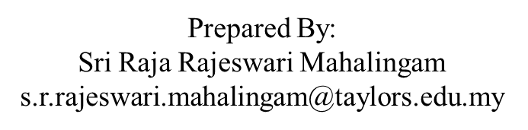
APPLICATION CHEMISTRY
A2 LEVEL
ANALYTICAL CHEMISTRY
CHAPTER 8:
CHROMATOGRAPHY

Slide 2
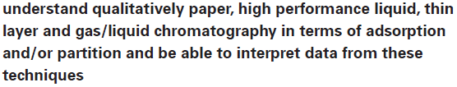
What you should know…

Slide 3
Chromatography
Origin of the technique in the separation and analysis of coloured dyes and plant pigments.
Four techniques will be described here:
  paper chromatography (PC),
  thin layer chromatography (TLC),
  gas/liquid chromatography (GLC) and
  high performance liquid chromatography (HPLC).

Slide 4
The basic principles and techniques
All chromatographic methods use the same principle of a mobile phase (a liquid or a gas) moving past a stationary phase.
Stationary phase may be a solid onto which the solutes are adsorbed (TLC, and some GLC and HPLC) or a liquid which is held in a thin film of the surface of an inert solid (PC, GLC and HPLC).

Slide 5
The basic principles and techniques
The solute molecules partition themselves between the stationary phase and the moving phase.
Unlike solvent extraction, however, the partition is not a true equilibrium, since the mobile phase is constantly moving past the area on the stationary phase where a particular solute is adsorbed/dissolved.
Thus a fresh partition with pure mobile phase, is continually being set up. The mobile phase should never become saturated with the solute.

Slide 6
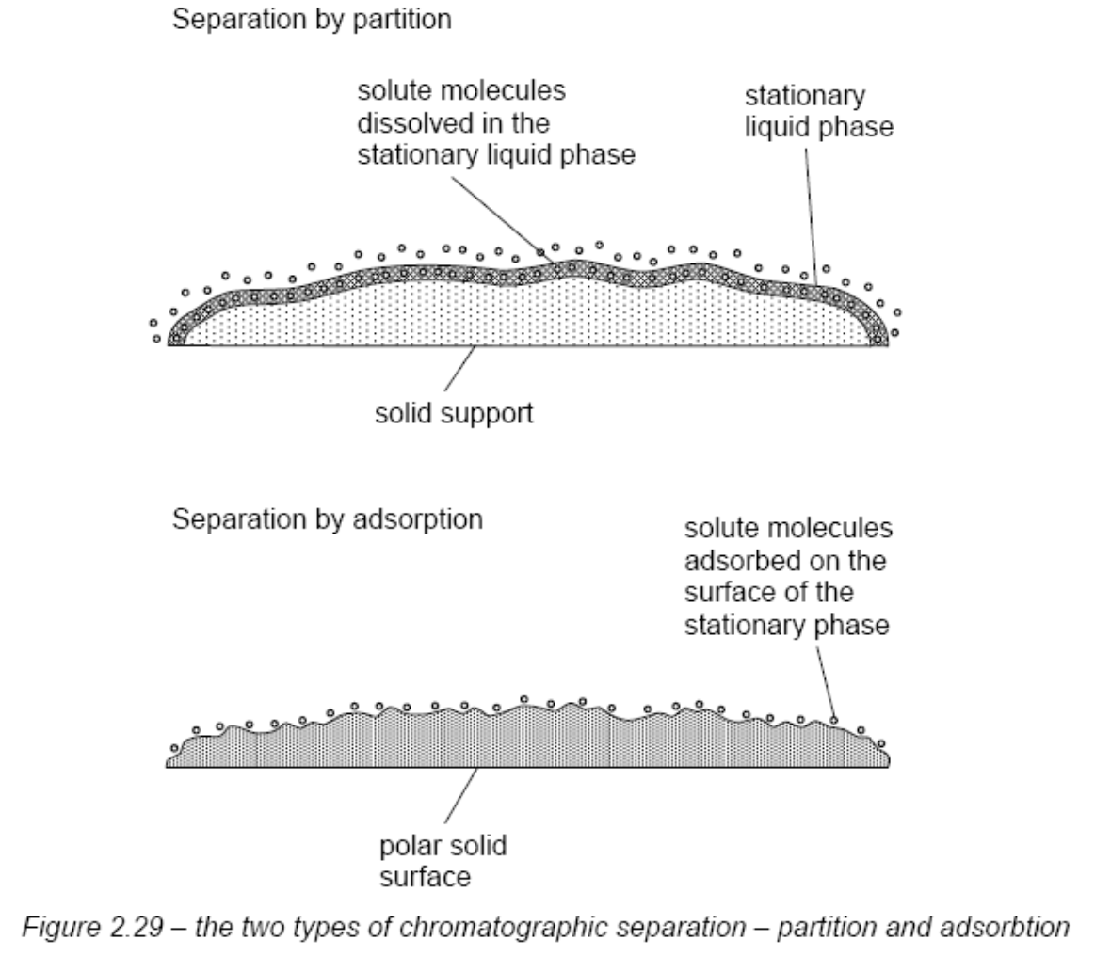

Slide 7
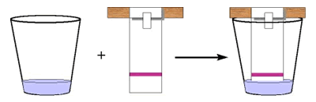
Paper Chromatography
The mixture to be separated and analysed is dissolved in a solvent, such as water or ethanol, and
A small spot of the solution is placed about 1 cm from the edge of a rectangular sheet of chromatography paper.
Spots of “reference” compounds may also be applied at the same distance from the edge.
Solvent is allowed to evaporate.

Slide 8
Paper Chromatography
The solutes adsorbed into the fibres of the paper.
(often by means of hydrogen bonding to the OH groups of the cellulose fibres, or more likely to the H₂O molecules that are still associated with cellulose, even when the paper feels dry).
The edge of the sheet - immersed in the chromatography solvent (the moving phase),
Capillary action draws the liquid up the sheet, and as it passes the point where the spot has been adsorbed, the compounds in the mixture will partition themselves between the cellulose surface and the moving solvent.

Slide 9
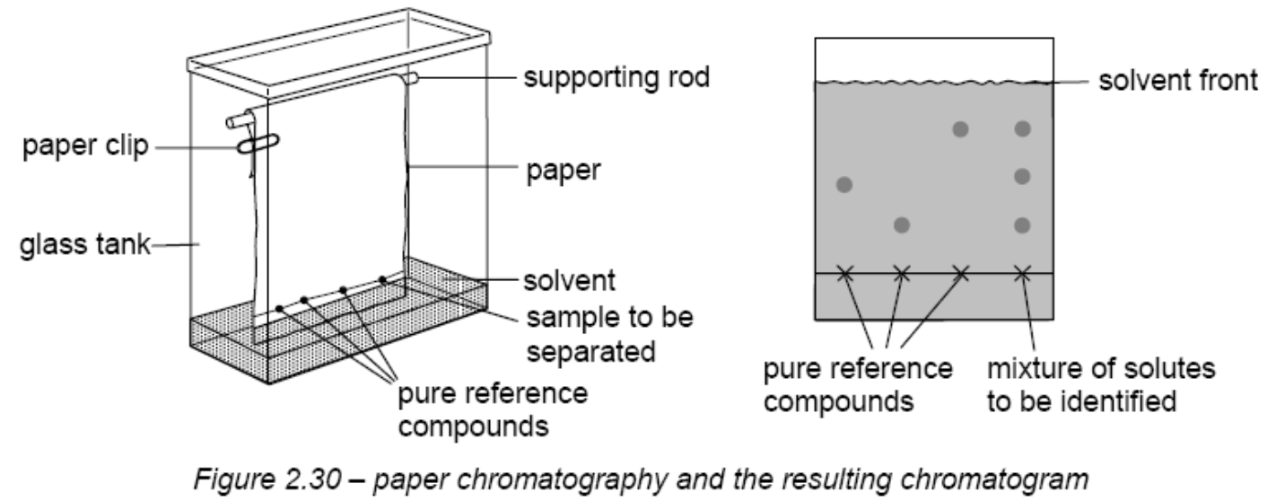
Paper Chromatography

Slide 10
Paper Chromatography
The more strongly a compound is adsorbed, the less likely it is to be drawn off the cellulose surface.
Those solutes that are weakly adsorbed, or which have a high solubility in the moving phase, will be drawn up the paper as the solvent front ascends.
The solvent is usually less polar than the cellulose surface and its associated water layer;
  so polar, strongly hydrogen bonded compounds only travel to a small degree,
  whereas the less polar and less hydrogen bonded compounds travel a larger distance.

Slide 11
Paper Chromatography
Once the solvent has reached the top end of the sheet of paper, the paper is removed and the solvent is allowed to evaporate.
All solutes will now be re-adsorbed onto the area of the paper where they had reached, and their presence can be detected by their colour, or by their UV absorbance.
For colourless compounds, an easy way of visualising the spots is to place the paper in a beaker with a few iodine crystals.

Slide 12
Paper Chromatography
Vapour is preferentially absorbed by the less polar solute spots, making them appear brown.
Paper can be sprayed with a dilute solution of a reagent that forms colours with the compounds contained in the spots.
Ninhydrin is used to visualise amino acids and small peptides;
Molisch’s reagent can be used for sugars in general;
Tollens’ reagent can be used for reducing sugars such as glucose and maltose.

Slide 13
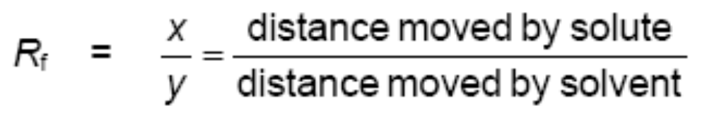
Paper Chromatography
The ratio R_{f} , called the retention ratio (or retardation factor), is defined by
Each solute or component has a characteristic R_{f} value for a given solvent.
This means that the value of R_{f} can be used to identify a possible component.

Slide 14
Paper Chromatography
Sometimes, different compounds may have very similar R_{f} values in a particular solvent, and so no separation can be achieved.
If a different solvent is tried, the partition coefficients of the two compounds between the new solvent and the stationary phase may be sufficiently different to allow a separation.

Slide 15
Paper Chromatography
A complex mixture can be more thoroughly analyzed by two-way paper chromatography.
One solvent is used first, and the solvent front allowed to reach the far edge of the paper, after which the paper is placed with the left side at the bottom for a second development using a different solvent.
The spots are then more widely dispersed and can be recognized from their positions on the final chromatogram.
Used to identify the amino acids obtained from the hydrolysis of a protein.

Slide 16
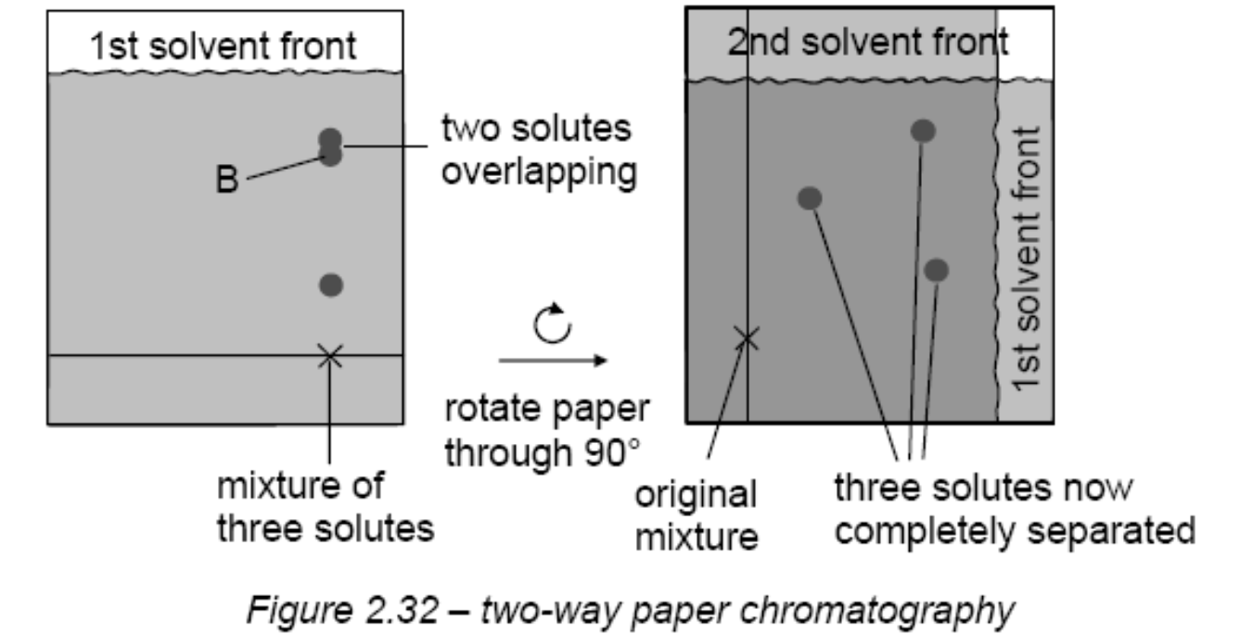
Paper Chromatography

Slide 17
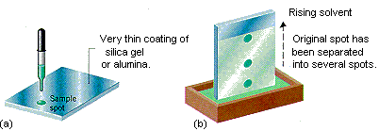

Thin Layer Chromatography
Similar to paper chromatography
Stationary phase is a thin layer of a solid such as alumina or silica supported on an inert base such as glass, aluminium foil or insoluble plastic.
Plate can be prepared by using slurry or purchase from suppliers.

Slide 18
Thin Layer Chromatography
Mixture to be analysed is 'spotted' at the bottom of the TLC plate and allowed to dry.
Plate is placed in a closed vessel containing solvent (the mobile phase) so that the liquid level is below the spot.
Advantages - results are more reproducible, and that separations are very efficient because of the much smaller particle size of the stationary phase

Slide 19
Thin Layer Chromatography
Solvent ascends the plate by capillary action - liquid filling the spaces between the solid particles.
This technique is usually done in a closed vessel to ensure that the atmosphere is saturated with solvent vapour and that evaporation from the plate is minimised before the run is complete.
The partition here is between the solute adsorbed onto the SiO₂ or Al₂O₃ particles (via polar/hydrogen bonded interactions, but also some acid/base attractions, since SiO₂ is slightly acidic, and Al₂O₃ slightly basic) and the solute dissolved in the moving phase.

Slide 20
Thin Layer Chromatography
The plate is removed when the solvent front approaches the top of the plate
Position of the solvent front is recorded.
TLC has applications in industry in:
  determining the progress of a reaction by studying the components present; and
  in separating reaction intermediates.

Slide 21
Thin Layer Chromatography
The reaction mixture is 'painted' across the TLC plate instead of a single spot.
The line of product after separation is cut out of the plate and dissolved in an appropriate solvent.

Slide 22
Thin Layer Chromatography
The ways in which spots of colourless compounds on a TLC plate can be visualised are similar to those used for PC.
Additional technique is often used for compounds containing aromatic rings, or other systems that absorb UV radiation at 254 nm:
Silica or alumina is impregnated with a fluorescent insoluble compound that absorbs UV light and emits it as visible light.
When placed under a UV lamp, the plate emits a bright white light except where a UV absorbing compound is situated. Here, a dark spot is observed.

Slide 23
Gas/Liquid Chromatography
Mobile phase : gas
Stationary phase : Non-volatile liquid coated onto small inert particles
The particles are packed into a narrow glass column a few mm in diameter and between 1 m and 3 m long.
The column is mounted inside an oven whose temperature can be controlled, or even programmed to increase as the separation is underway.

Slide 24
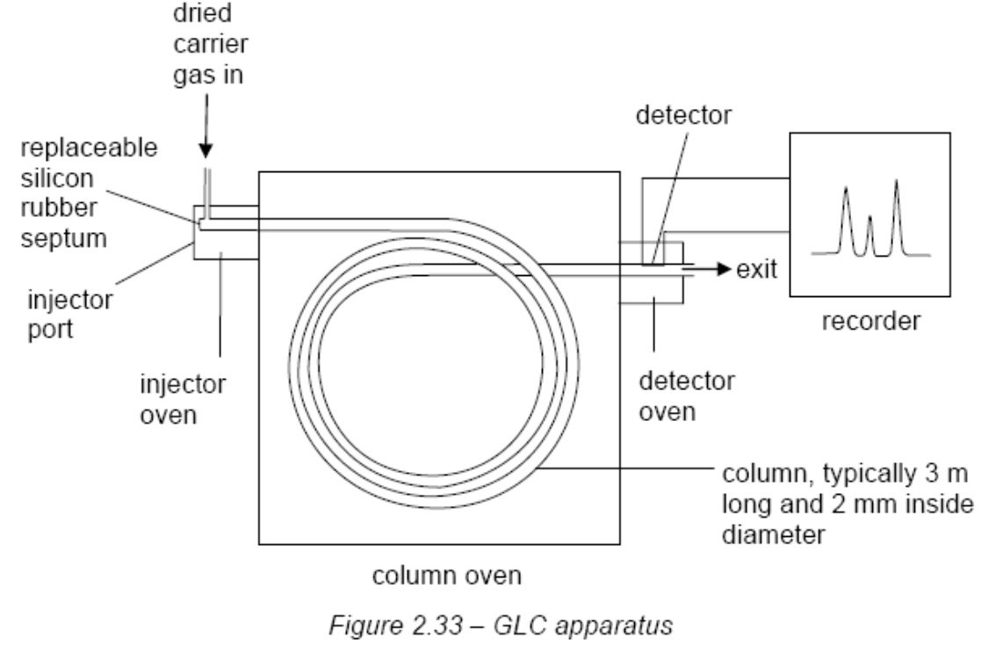
Gas/Liquid Chromatography

Slide 25
Gas/Liquid Chromatography
For separation or identification the sample must be either a gas or have an appreciable vapour pressure at the temperature of the column.
The sample is injected through a self-sealing disc (a rubber septum) into a small heated chamber where it is vaporised if necessary.
Although the sample must all go into the column as a gas, once it is there the temperature can be below the boiling point of the components as long as they have appreciable vapour pressures inside the column.

Slide 26
Gas/Liquid Chromatography
This ensures that all the fractions pass through the column over a reasonable time span. The injector oven is usually 50-100 °C hotter than the start of the column.
The sample is then taken through the column by an inert gas (known as the carrier gas) such as helium or nitrogen, which must be dry to avoid interference from water molecules.
Dried by passing it through anhydrous copper(II) sulphate or self-indicating silica.

Slide 27
Gas/Liquid Chromatography
Unwanted organic solvent vapours can be removed by passing the gas through activated charcoal.
The column is coiled so that it will fit into the thermostatically controlled oven.

Slide 28
Gas/Liquid Chromatography
The temperature of the oven is kept constant for a straightforward separation.
If there is a large number of components, or if they have similar affinities for the stationary phase relative to the mobile phase, then it is common for the temperature of the column to be increased gradually.
Gives a better separation if the boiling points of the components are close.
Faster separation if some components are relatively involatile.

Slide 29
Gas/Liquid Chromatography
The fractions progress to the end of the column, and then to a detector.
Two types of detector:
  thermal conductivity detectors and
  flame ionisation detectors (FID)
It is the one that is most commonly used, and is particularly useful for detecting organic compounds.

Slide 30
Gas/Liquid Chromatography
The gas from the column is mixed with hydrogen and air, and is then burned.
Some CH• radicals, which are formed on combustion, are then oxidised to CHO⁺ ions.
These ions produce a current of about 1 μA through a cathode to a sensitive amplifier and then to a computer or chart recorder.

Slide 31
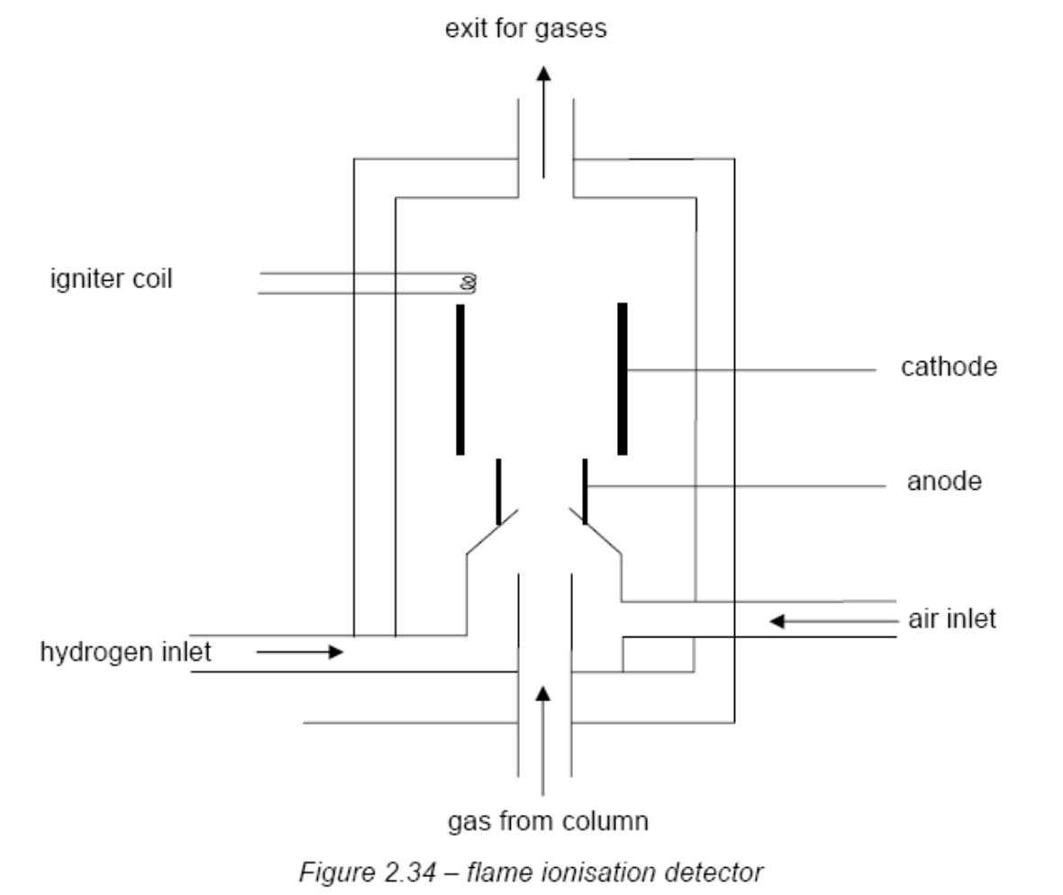

Slide 32
Gas/Liquid Chromatography
Once a mixture has been separated by GLC its components need to be identified.
For known substances this can be done from a knowledge of the time it takes for the components to reach the detector once they have been injected into the column.

Slide 33
Gas/Liquid Chromatography
These are known as retention times and will vary depending on each of the following:
  the flow rate of the carrier gas;
  the temperature of the column;
  the length and diameter of the column;
  the nature of and interactions between the component and the stationary and mobile phases; and
  the volatility of the solute.

Slide 34
Gas/Liquid Chromatography
Each substance to be identified by GLC is run through the column so that its retention time can be determined.
For compounds of completely unknown structure or composition the components must be collected individually and then analysed by using another method – e.g. mass spectrometry.

Slide 35
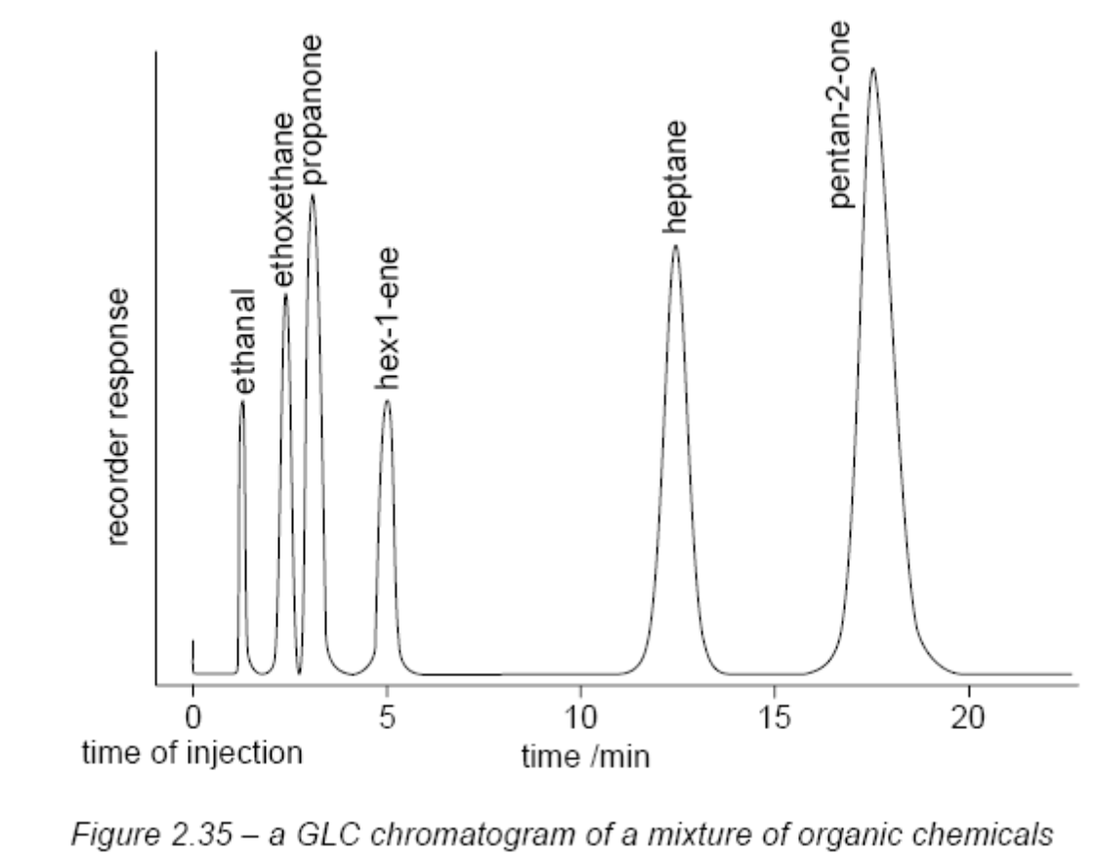
Gas/Liquid Chromatography

Slide 36
High Performance Liquid Chromatography
Very similar to GLC.
Main differences are that the moving phase is a high-purity solvent rather than a gas.
Columns are shorter (10 – 30 cm) and the components are usually detected by measuring the absorbance of UV radiation through a microcell at the end of the column.
The efficiency of a separation increases if the particles in the stationary phase are made smaller.

Slide 37
High Performance Liquid Chromatography
This is because the solute can equilibrate more rapidly between the two phases.
The stationary phase in an HPLC column normally consists of uniform porous silica particles of diameter 1 x 10⁻⁶ m, with surface pores of 1 x 10⁻⁹ m diameter to increase the surface area.
Sometimes the particles are coated with molecular fragments of a solvent having particular polar groups, joined to the silica by covalent bonds.
This ensures they do not dissolve in the mobile phase.

Slide 38
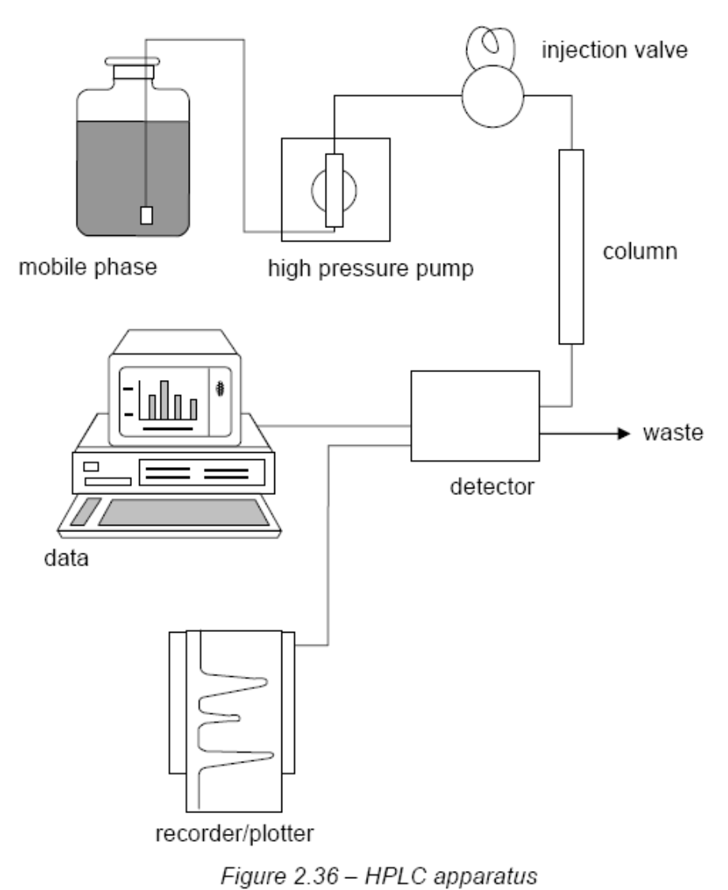

Slide 39
High Performance Liquid Chromatography
To ensure reproducibility of retention times, various factors have to be controlled exactly.
A constant flow rate is maintained by special twin cylinder reciprocating pumps, generating steady precise pressures of up to 100 atmospheres.
Even with such high pressures, the flow rate through the column is small (about 2 cm³ min⁻¹), due to the tightly packed small particles of the stationary phase.

Slide 40
High Performance Liquid Chromatography
Nevertheless, because the column volume is small the timing of the injection of the sample must be precise if an accurate retention time is to be measured.
For example, a 20 cm column of diameter 0.4 cm has a volume of about 2.5 cm³. The mobile phase will take only 75 sec to travel through the whole of this column.

Slide 41
PAST YEAR QUESTIONS

Slide 42

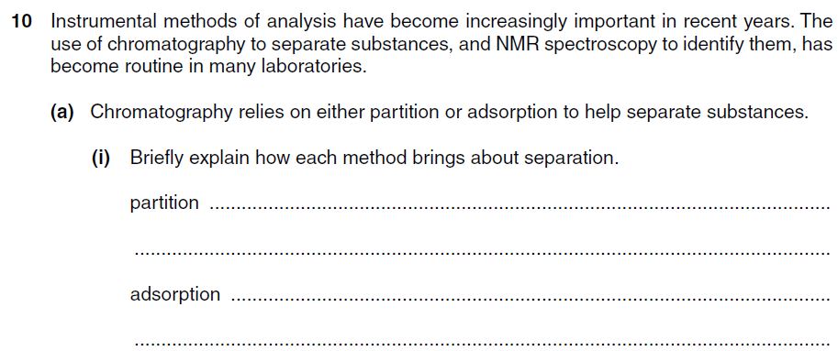
Question 1

Slide 43
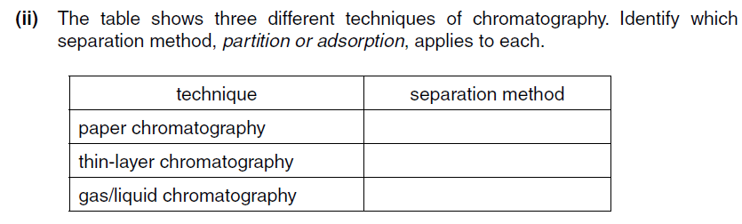

Slide 44
